Slide 1
Capstone project
TEAM-5
Mysha Maliha, Michael Bechtold, Xuan Phung, Chang Vang

Slide 2

Agenda
Introduction
Vision and Scope
Business Value
Feasibility Studies
Software Development Methodology
Proposed System Functionalities
Initial use case diagram of our system
Hardware and Software Requirements
Project log (when you met, who attended, etc.)
Project plan (what might be in each iteration, subject to change, who will be in charge of what piece)

Slide 3
Introduction
The Problem: Students often struggle with managing tight budgets while balancing academic and personal needs.
Many local restaurants offer discounts, but students may not be aware of them or find it inconvenient to search across multiple sources.
This lack of accessibility results in missed opportunities for both students and businesses.
Our app aims to centralize these discounts, improving convenience, saving money, and promoting partnerships between students and local food vendors.
The project revolves around the development of an application designed to help students find discounted meals and special deals at local restaurants, cafes, and food vendors.
This platform will aggregate discounts into a single, user-friendly interface, enabling students to save money while enjoying affordable dining options.

Slide 4

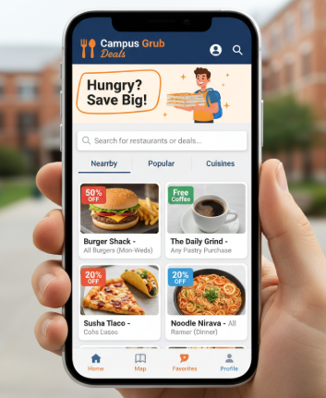
Vision and Scope
To become the go-to platform for students seeking affordable meals by bridging the gap between student demand and local business offerings.
Scope
Provide students with real-time access to discounted meals and offers.
Allow restaurants and cafes to advertise special student deals.
Enable users to filter results by price, location, cuisine, or popularity.
Future enhancements may include loyalty points, reviews, AI-based personalized suggestions, features such as map integration, and QR code redemption.

Slide 5
BUsiness VAlue
Categories | Reason | Cost
Development payroll for 4 weeks | $25/hour a person at 40hrs/week = $4000 | $4000
Hardware and Software Reqs. | Intial registration of $25 to publish on playstore and $99 yearly for applestore | $25 + $99/yearly
Total Cost |  | $4025 +99/yearly
For Students: Reduced meal costs, increased savings, and easier access to deals.
For Businesses: Increased visibility, higher student engagement, and potential sales growth.
For Institutions: Support student well-being by helping them access budget friendly meals.
Categories | Profit
Restaurant sign-up | $10 per month for each meal listed
5 restaurants list 2 meals each | $100/monthly
Profit margins | 40 weeks to cover cost and then profit

Slide 6
Feasibility Studies
Description:
This meal discount program is large need of college student trying to save money while in college and save money until they have landed their big break.
Users will connect to a hub where they can find discounts on food that would normally be wasted.
Prices and menus will be display to users and location of restaurants and stores will be displayed on a map.
Technology Considerations:
Database the need to be updated with inventory and prices by restaurants and stores
Mapping location displayed in app or navigation to google maps or alike
Market Place and Marketing Strategy:
Student lounge, hallways of the campus, school bulletin boards / websites
Organization/Staffing:
There are 4 members of our team, and we should have the rough version of the program in about a month

Slide 7
Proposed System Functionalities
There should be two interfaces
Customer interface
Mobile/Web based app to find the deals based on filter options: Type of cuisine, price range, and location.
Map of restaurant
Order placement (remove from database)
Restaurant Interface
Mobile / Web based app lets users:
Enter or Remove the deals in the database
Modify entries in the database
Non-Functional Requirements: ​
Accessibility – Application on IOS and Android platform​s
Performance – Smooth and responsive UI

Slide 8
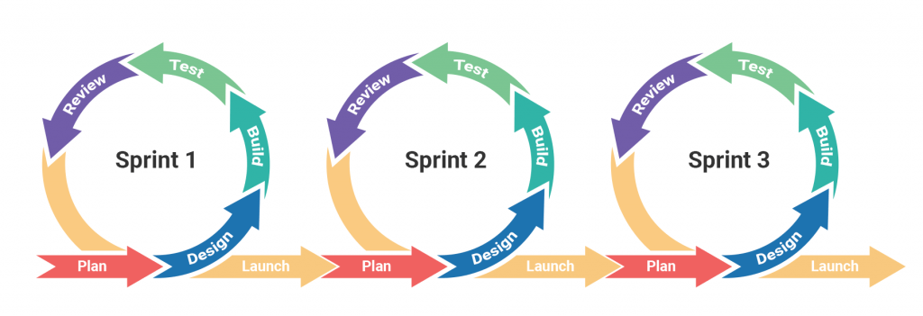
Software Development Methodology
We will use the Agile methodology, particularly Scrum, due to its iterative approach, flexibility, and continuous feedback cycles. This ensures features can be delivered incrementally and refined based on user input.

Slide 9
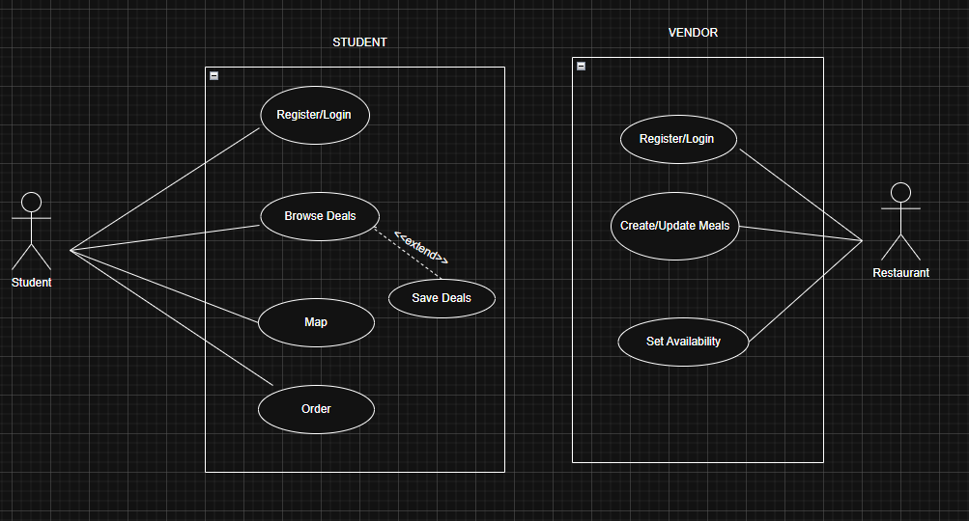
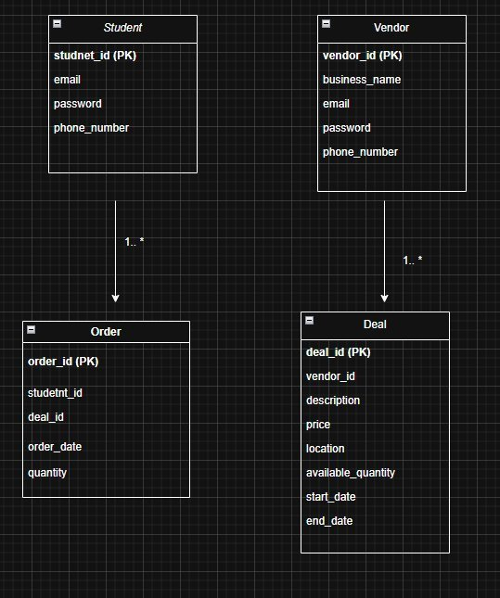
uses case diagram

Slide 10
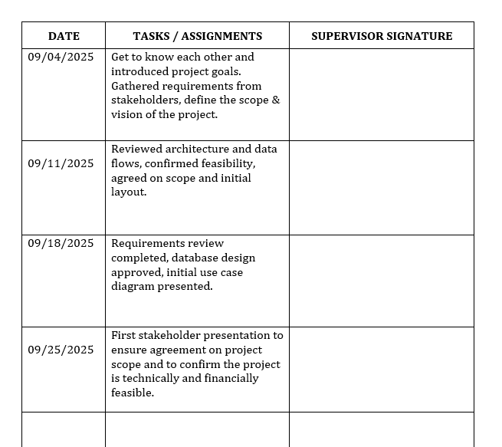
Project Log – Iteration 1
09/04/2025
Get to know each other and introduced project goals.
Gathered requirements from stakeholders.
Defined the scope & vision of the project.
09/11/2025
Reviewed architecture and data flows.
Confirmed feasibility.
Agreed on scope and initial layout.
09/18/2025
Requirements review completed.
Database design approved.
Initial use case diagram presented.
09/25/2025
First stakeholder presentation to ensure agreement on project scope.
Confirmed the project is technically and financially feasible.

Slide 11
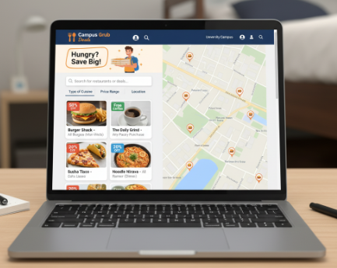
Hardware and software requirements
Hardware Requirements: Development is on laptop
Software Requirements
Programming languages; Java, Python, & PHP
Front-end: HTML & CSS, Bootstrap, JavaScript, React, JavaFX
Backend Frameworks: Java
DataBase & Other Tools: My SQL, IntelliJ, VS Code, GitHub, Google Maps API

Slide 12
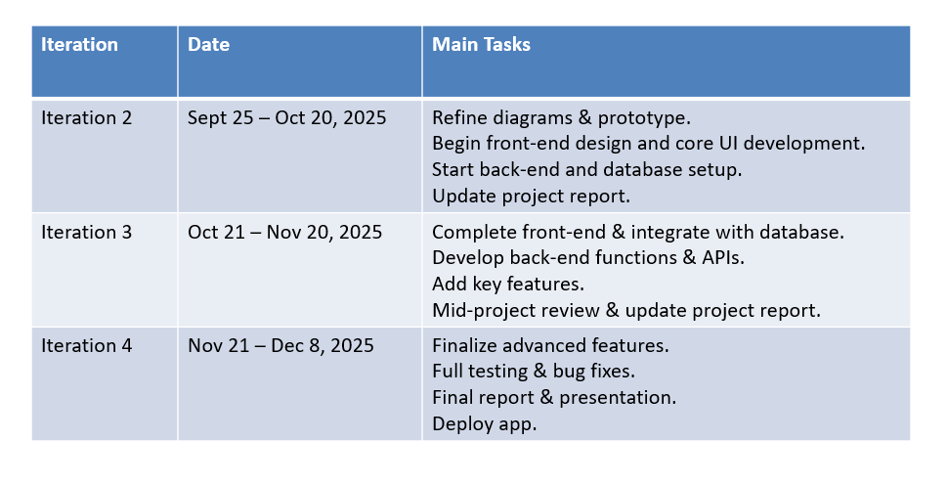
Project plan

Slide 13
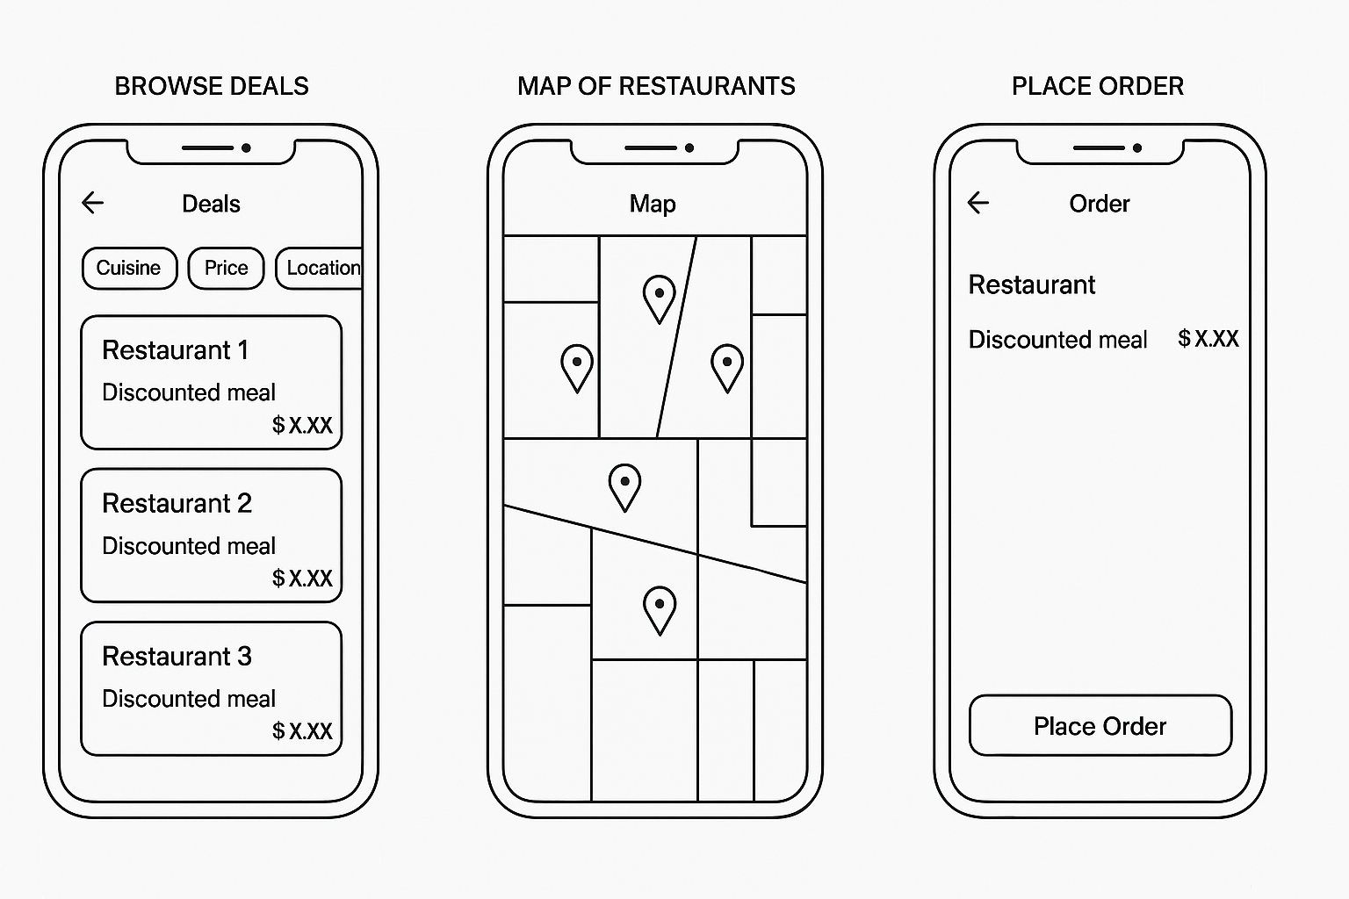
Prototype
Rough UI Prototype
Browsing deals
Google Map API
Placing orders

Slide 14
THANK YOU

